Slide 1
Townhall 2026
30-Jul-2026

Slide 2
Agenda
▪ Human Resources Department
- New Staff Reporting : Jan-2026 to Jul-2026
- Staff Promotion – First Half FY2026
- Best Employee of The Month
- Award – Top Scorer E-Learning Assessment (Batch 1, 2 & 3)
- Award – Fastest Response for Quiz E-Learning (Batch 1, 2 & 3) - Office & Site Attire
- SOCSO - Non-Occupational Accident Scheme (SKBBK)
- Employees Update on HR Matters
▪ Project & Construction Department
- Ductwork Calculation
- Equipment Responsibility & Best Practices

Slide 3
Agenda
▪ Engineering Department (Project SKSMC, IVF Level 7)
- Ducting Modification to Eliminate Excessive Sound
▪ Compliance, Training & Development Department
- Results for Quality Objective 2025
- Results of Internal Audit 2026
- External Audit 2026
- e-Learning : Training Timeline Proposed for Year 2026 (Batch 1,2,3 & 4)
- Training by Batch
- Class & Topic Proposed for Year 2026

Slide 4
Agenda
▪ Project Admin
- Standard Folder Update (Project/Job/Tender)
- Equipment Booking & Material Stock Out
- Flight & Accommodation Booking
- Asset Tagging
▪ Document Control
- Latest Document Updates
- Where to find LUFTER documents?
- Document Codification
▪ Account Department
- e-Invoice Claim
▪ Q&A Session

Slide 5
Human Resource Department

Slide 6

New Staff Reporting : Jan-2026 to Mar-2026
Month | Name | Position | Department / Project
Jan-2026 | Mohamad Zulfadhli Bin Zulkepli | Engineer – Project | Engineering
 | Nabila Nurashyura Binti Norazlee | Executive – Document Controller cum Project Admin | Project & Construction
Feb-2026 | Noraini Binti Ruslan | Executive – Document Controller | Engineering
 | Muhammad Hazim Bin Mahadi | Engineer – Project | Project & Construction – PDEX02
 | Azfar Aeiman Bin Zulkifli | Supervisor – Project | Project & Construction – PGSK02 / JGSK57
Mar-2026 | Lim Zhi Qin | Senior Engineer – Project | Engineering / PGSK02
 | Muhammad Hafni Syakir Bin Abdul Aziz | Executive – Document Controller | CTD / PDEX02
 | Amri Mukhlis Bin Idris | Executive – Project | Engineering / JGSC10
 | Muhammad Nuriman Bin Mohd Ismam | Executive – Project | Engineering / PPLS04
 | Shahril Azri Haikal Bin Wasrilbayura | Executive – Project | CTD / PDEX02

Slide 7
New Staff Reporting : Apr-2026 to Jul-2026
Month | Name | Position | Department / Project
Apr-2026 | Nur Qamarina Sofia Binti Azahar | Executive – Validation | CTD / PDEX02
 | Muhammad Shazany Bin M. Shazally | Executive – Project | Project & Construction - PSLM01
May-2026 | Ooi Cheah Peng (Zerra) | Manager – Operations | Engineering
 | Muhammad Hazim Bin Mohd. Arif | Engineer - Project | Project & Construction - PSLM01
Jul-2026 | Sharifah Arina Binti Syed Roslin | Executive – Admin cum Personal Assistant | HR & Admin
 | Luqman Nul Hakim Bin Rashide | Engineer – Project | CTD

Slide 8

Staff Promotion – First Half FY2026
Congratulations to:
No. | Name | Previous Position | Current Position
1. | Leong Wai Lek | Senior Engineer – Project | Assistant Manager – Project
2. | Adib Safuan Bin Ruslan | Engineer – Project | Senior Engineer – Project
3. | Mohd Izzan Irfan Bin Zanzuri | Engineer – Project | Senior Engineer – Project
4. | Syed Mohamed Fairiq Bin Syed Yahya | Engineer – Project | Senior Engineer – Project
5. | Muhammad Haris Bin Khairuzi | Engineer – Project | Senior Engineer – Project
The Management continuing to review staff performance for a career growth in LUFTER!!

Slide 9
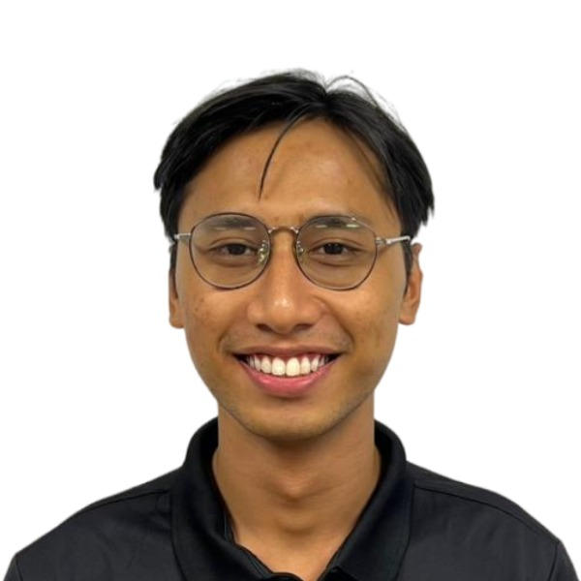
Best Employee of the Month
Personal update: Muhamad Zharif Bin Mohd Samidi (Engineer – Project)
Join Lufter Sdn Bhd since Aug-2025.
His Manager (Ahmad Na’im) comments as below:
Good communication with clients and follow-up on document approvals.
Good documentation and implementation of project SOPs.
Good communication with project team (Supervisor & Manager).

Slide 10
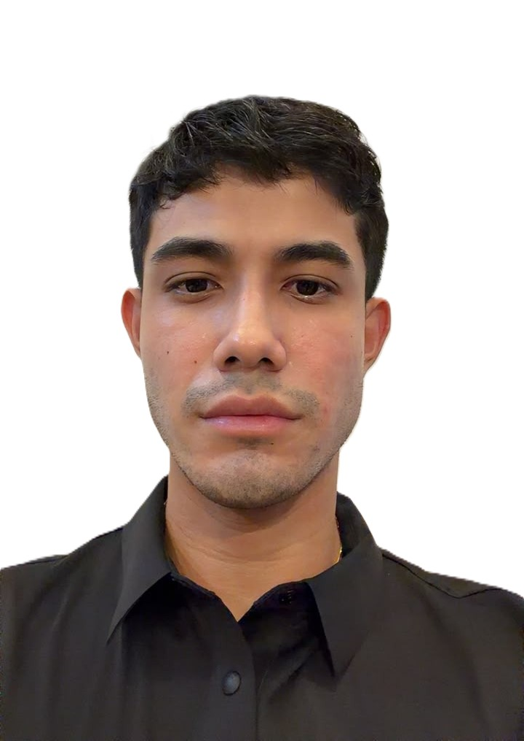
Best Employee of the Month
Personal update: Dhiren Singh Lim Ranu (Engineer – Project)
Join Lufter Sdn Bhd since Oct-2025.
His Manager (Yuk Lun) comments as below:
I would like to nominate him as the Best Player for his outstanding commitment and contribution to the team. He consistently demonstrates a strong sense of responsibility, works collaboratively as a supportive team player, and is always willing to take on new challenges.
What sets him apart is his proactive attitude in seeking solutions. Whenever he encounters difficulties, he actively consults with his superiors and senior colleagues to gain insights and identify the most effective way forward. His positive mindset, dedication, and willingness to learn have made him a valuable asset to the team.

Slide 11
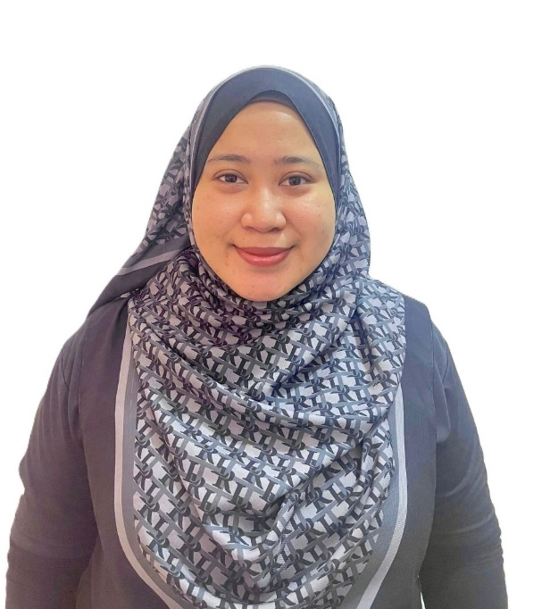
Best Employee of the Month
Personal update: Nabila Nurashyura Binti Norazlee
(Executive – Document Controller cum Project Admin)
Join Lufter Sdn Bhd since Jan-2026.
Her Manager (Angie Ong) comments as below:
- Always willing to take on additional task and always proactive in asking when she doesn't understand.

Slide 12

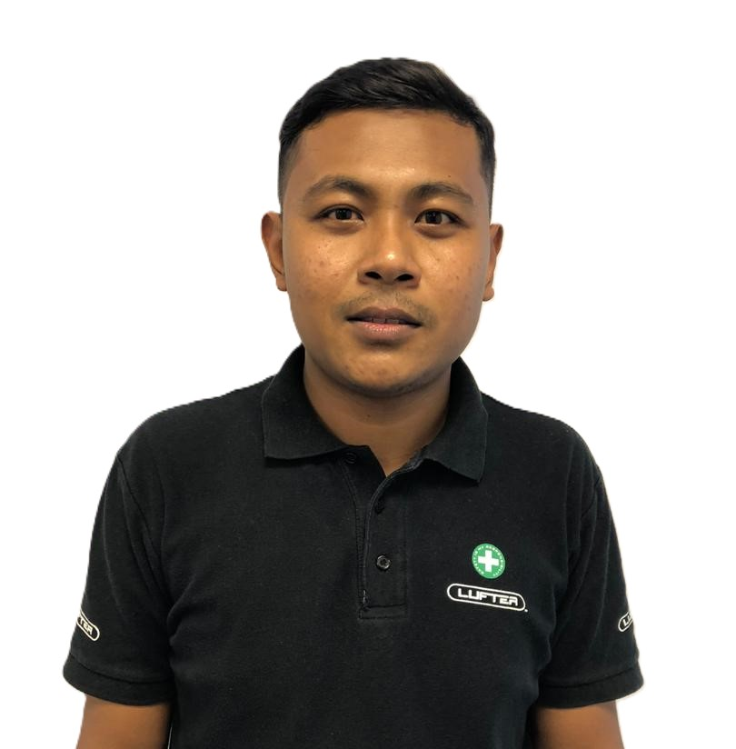
Award – Top Scorer E-Learning Assessment : Jul-2025 to Dec-2025
(Batch 1)
Izzat Zul Majdi Bin Ahmad Taufik
Lead Supervisor – Project
Score = 100%
Token of appreciation = RM150.00

Slide 13
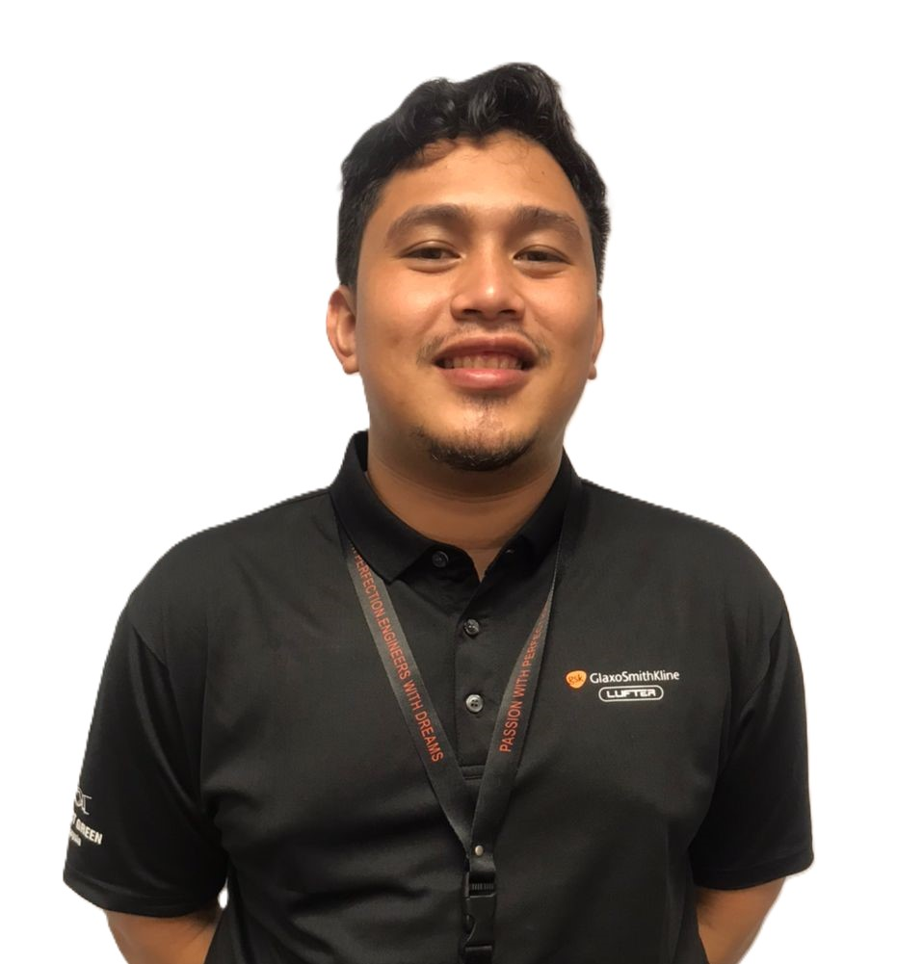
Award – Fastest Response for Quiz E-Learning : Jul-2025 to Dec-2025
(Batch 1)
Adib Safuan Bin Ruslan
Senior Engineer – Project
Token of appreciation = RM50.00

Slide 14
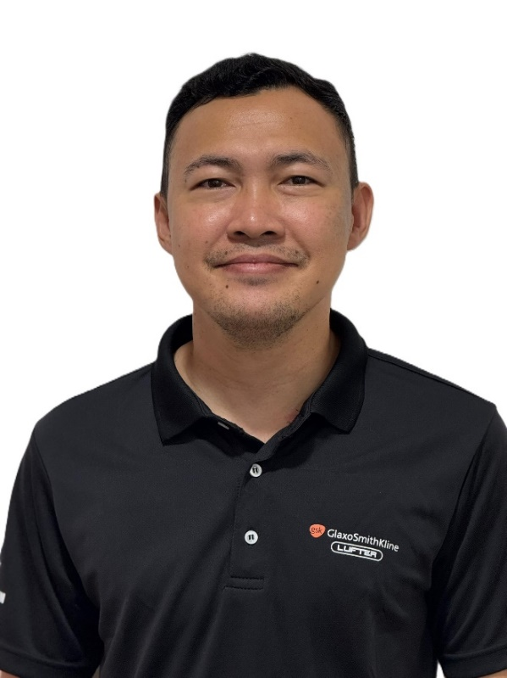
Award – Top Scorer E-Learning Assessment : Jul-2025 to Dec-2025
(Batch 2)
Khairul Anwar Lim Bin Khalil Idham Lim
Engineer – Project
Score = 82%
Token of appreciation = RM150.00

Slide 15
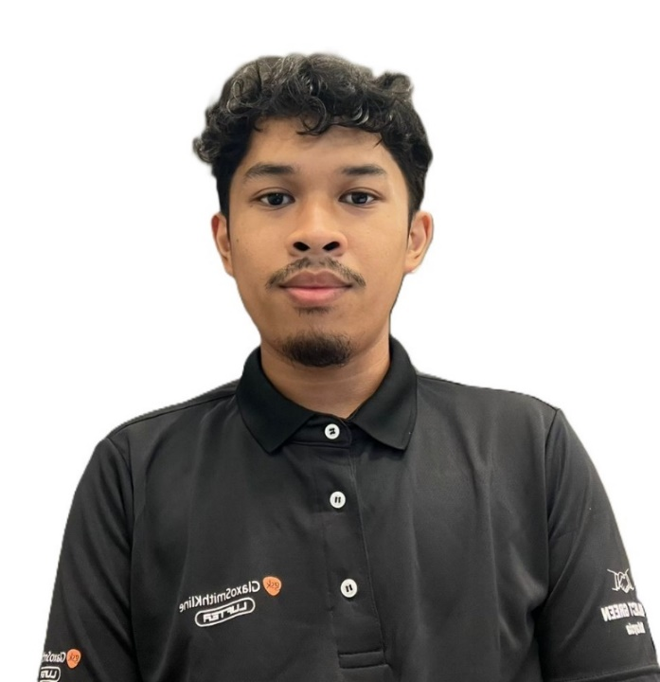
Award – Fastest Response for Quiz E-Learning : Jul-2025 to Dec-2025
(Batch 2)
Nor Danial Iman Bin Nor Hisham
Supervisor – Project
Token of appreciation = RM50.00

Slide 16
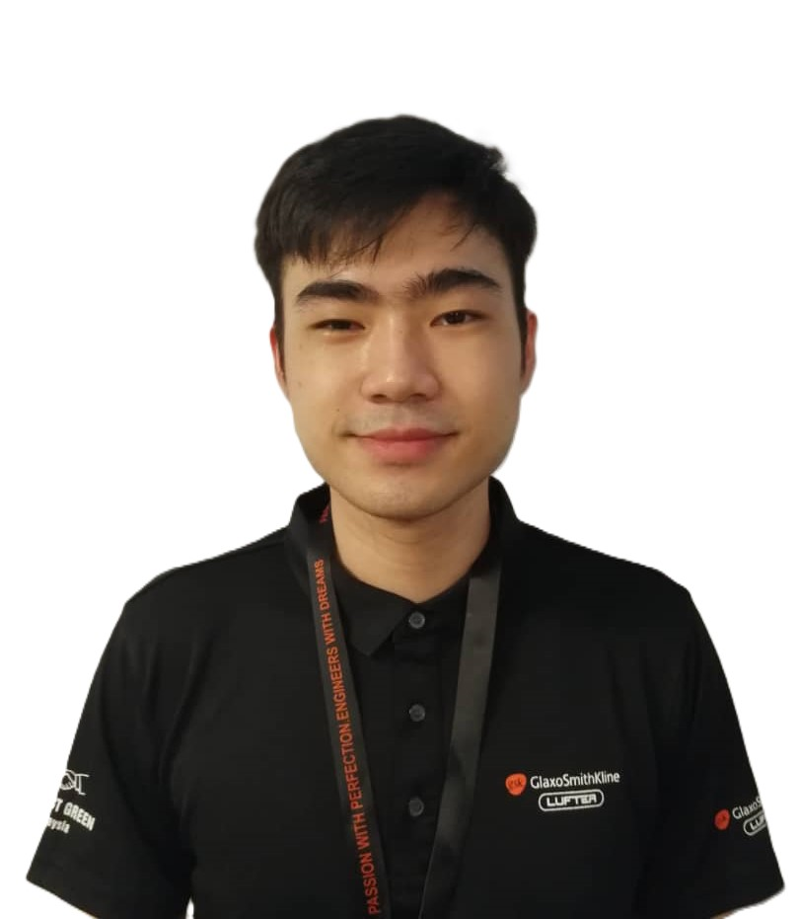
Award – Top Scorer E-Learning Assessment : Jan-2026 to Jun-2026
(Batch 1)
Leong Wai Lek
Assistant Manager - Project
Score = 95%
Token of appreciation = RM150.00

Slide 17

Award – Fastest Response for Quiz E-Learning : Jan-2026 to Jun-2026
(Batch 1)
Adib Safuan Bin Ruslan
Senior Engineer – Project
Token of appreciation = RM50.00

Slide 18
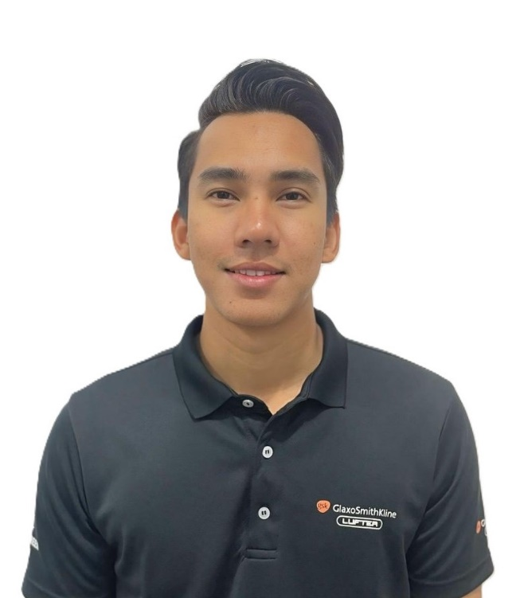
Award – Top Scorer E-Learning Assessment : Jan-2026 to Jun-2026
(Batch 2)
Muhammad Izzat Bin Abd Manaf Engineer – Project
Score = 92%
Token of appreciation = RM150.00

Slide 19

Award – Fastest Response for Quiz E-Learning : Jan-2026 to Jun-2026
(Batch 2)
Khairul Anwar Lim Bin Khalil Idham Lim
Engineer – Project
Token of appreciation = RM50.00

Slide 20
Award – Top Scorer E-Learning Assessment : Jan-2026 to Jun-2026
(Batch 3)
Dhiren Singh Lim Ranu
Engineer – Project
Score = 88%
Token of appreciation = RM150.00

Slide 21
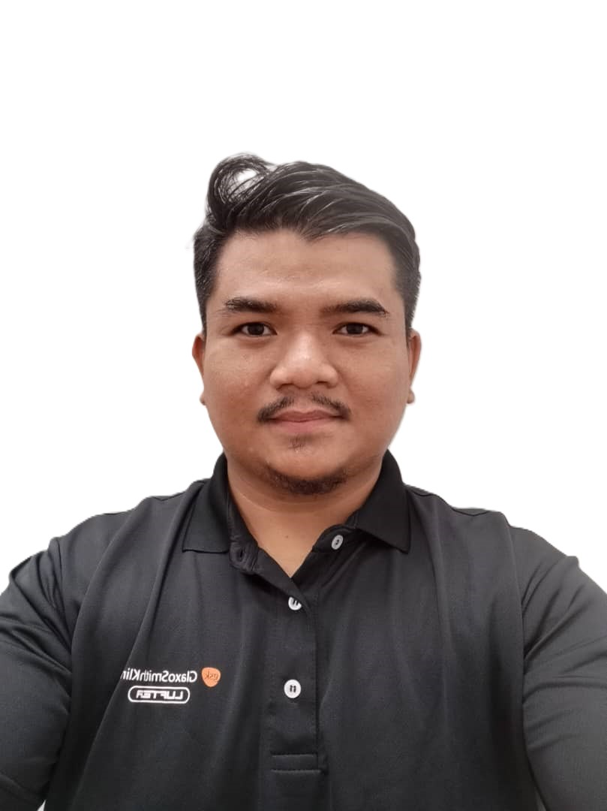
Award – Fastest Response for Quiz E-Learning : Jan-2026 to Jun-2026
(Batch 3)
Yazrin Afif Bin Yahaya
Engineer – Electrical & Instrumental
Token of appreciation = RM50.00

Slide 22
Office & Site Attire
Position | Monday | Tuesday | Wednesday | Thursday | Friday | Saturday / Sunday | 1st of every month / Tender Interview / Official Meeting
Male Manager | Dexcom (Grey) | Dexcom (Grey) | Lufter (Navy Blue) | GSK (Black) | GSK (Black) | Lufter (Navy Blue) | Batik
Female Manager | Office – Own Attire | Lufter (Navy Blue) | Lufter (Navy Blue) | GSK (Black) | GSK (Black) | Lufter (Navy Blue) | n/a
 | Project – Dexcom (Grey)
Male Executive | Dexcom (Grey) | Lufter (Navy Blue) | Lufter (Navy Blue) | GSK (Black) | GSK (Black) | Lufter (Navy Blue) | n/a
Female Executive | Dexcom (Grey) | Lufter (Navy Blue) | Lufter (Navy Blue) | GSK (Black) | GSK (Black) | Lufter (Navy Blue) | n/a

Slide 23

SOCSO - Non-Occupational Accident Scheme
PERKESO (SOCSO) has introduced a new protection scheme known as “LINDUNG 24 JAM”, which take effect since 01-Jun-2026.
- Under this new scheme, employees will receive expanded SOCSO coverage for accidents occurring outside of working hours, including non-work-related incidents such as:
√ Accidents at home
√ Weekend or personal commuting accidents
√ Injuries during recreational or sports activities
√ Public place accidents and other eligible incidents outside the workplace
This scheme covers accidents that occur in Malaysia only

Slide 24
SOCSO - Non-Occupational Accident Scheme
- The contribution for this scheme will be fully borne by employees and deducted together with the monthly payroll contribution.
Contribution Rate:
The additional contribution rates are expected to be implemented in phases as follows:
Phase | Contribution Rate
First 2 years 2026 – 2027 | 0.75%
Following 3 years 2028 - 2030 | 1.00%
Year 6 onwards | 1.25%

Slide 25
SOCSO - Non-Occupational Accident Scheme
As latest update from PERKESO (SOCSO) as below;
• It is no longer compulsory for local employees. Instead, participation is voluntary, and the contributions are fully borne by the employees. However, it remains mandatory for foreign workers in accordance with existing legal provisions.
• Employers shall pay contributions on behalf of employees for as long as the employee remains employed with them.

Slide 26
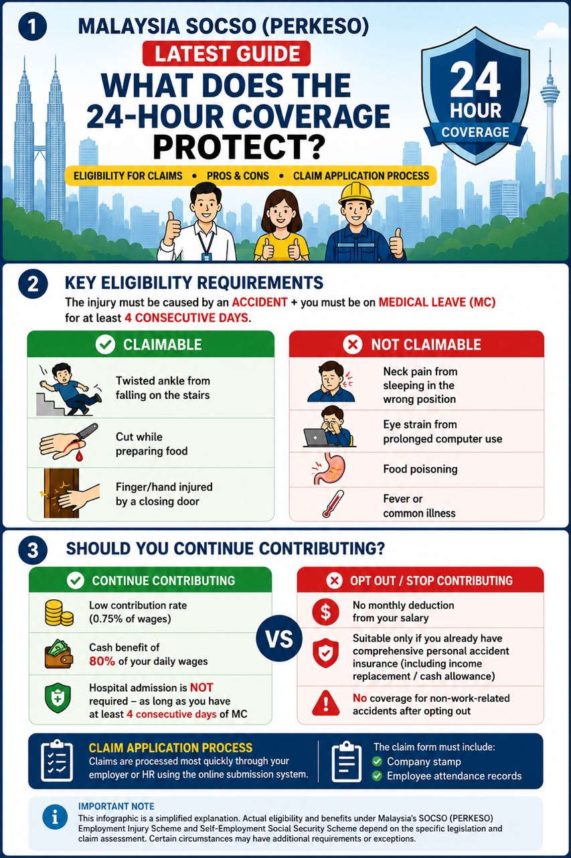
SOCSO - Non-Occupational Accident Scheme

Slide 27
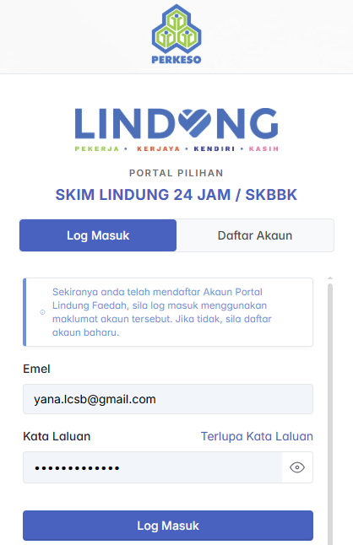
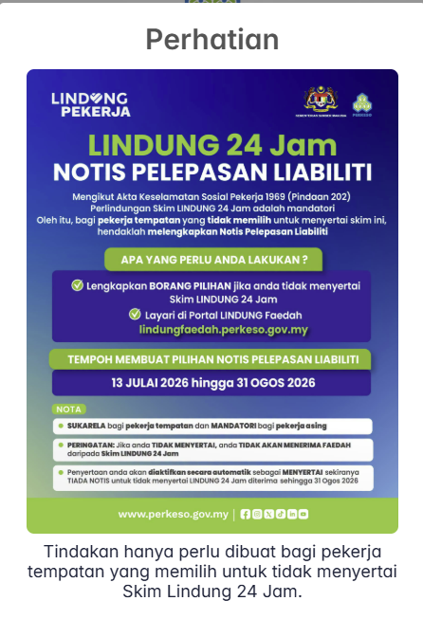


SOCSO - Non-Occupational Accident Scheme
https://lindungfaedah.perkeso.gov.my/auth/
- This is only applicable to staff who DO NOT want to contribute with SKBBK scheme.
- Staff declaration at SOCSO website from 13-Jul-2026 until 31-Aug-2026
- Staffs need to submit declaration form to HR
- If NO declaration form submitted, it will be automatically activated for this scheme and salary will be deducted as per percentage

Slide 28
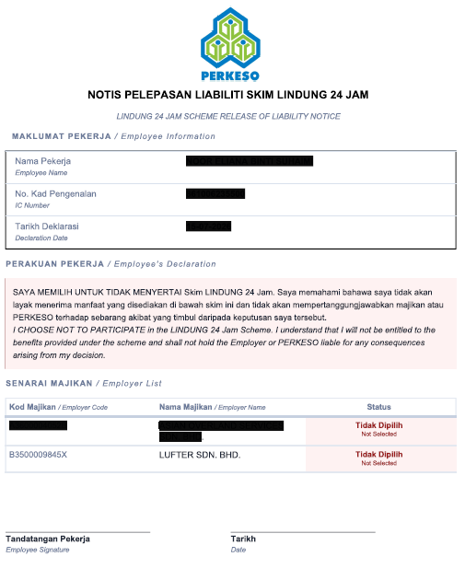
SOCSO - Non-Occupational Accident Scheme

Slide 29

Employees Update on HR Matters
All employees are reminded to promptly inform the HR department of any changes that may affect to your personal records such as below:
1. Changing in marital status –
Employees to inform Superior and to apply Marriage Leave at least one (1) week in advance, and update HR for record. (Supporting document is required)
2. Employees or spouse expecting a child (pregnancy) –
Employees to inform Superior and HR at least thirty (30) days before the commencement of leave. (Supporting document is required)
3. Employees to update on new born information eg: Name, MyKid no, Gender –
This information is for employees personal file and to ensure employees information is updated. (Supporting document is required)

Slide 30
Project & Construction Department
Ductwork Calculation

Slide 31
Objective
Ensure accurate duct quantity calculations.
Familiarize with ductwork SQFT calculation and verification methods.
Improve project profitability through better cost control.
Reduce variation orders and unnecessary additional costs.

Slide 32
Why Important?
Protect Project Profit Margin
Avoid Additional Purchase & Delivery Cost
Ensure Proper Airflow Performance
Maintain project budget
Protect company profit margin
Avoid unexpected cost overruns
Design airflow achieved
Comfortable room conditions
Compliance with project specifications
Better procurement planning
Avoid emergency purchases
Maintain project schedule

Slide 33
Step 1 – Verify Drawing info
- Verify duct size
- Verify duct length
- Verify all fittings & connections
- Verify latest drawing revision
Step 2 – Calculate Duct Quantity
- Calculate main & branch duct
- Calculate dropper duct
Step 3 – Cross Check & Verification
Compare your calculation with:
- Vendor quotation quantity
- Previous project unit rate
Verification Method

Slide 34
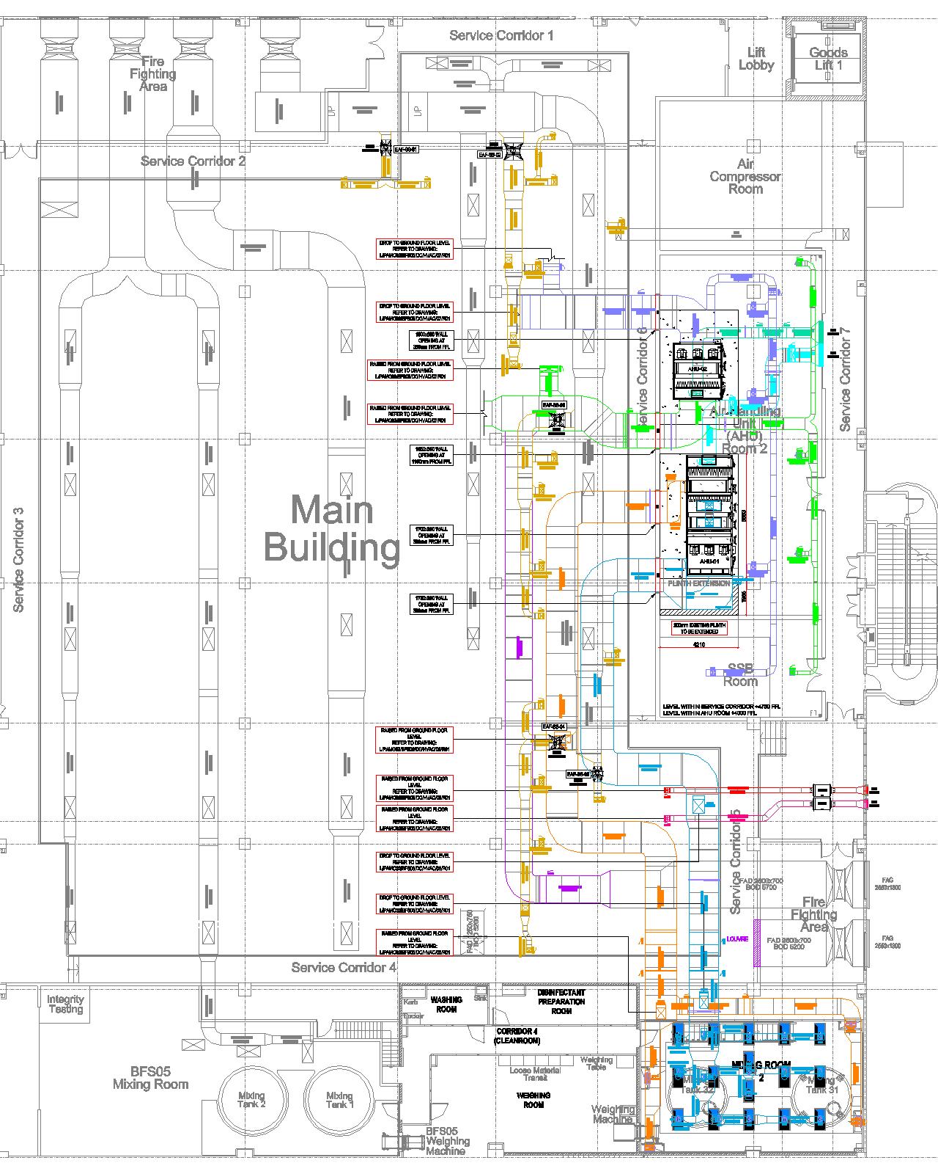
Ducting Layout

Slide 35
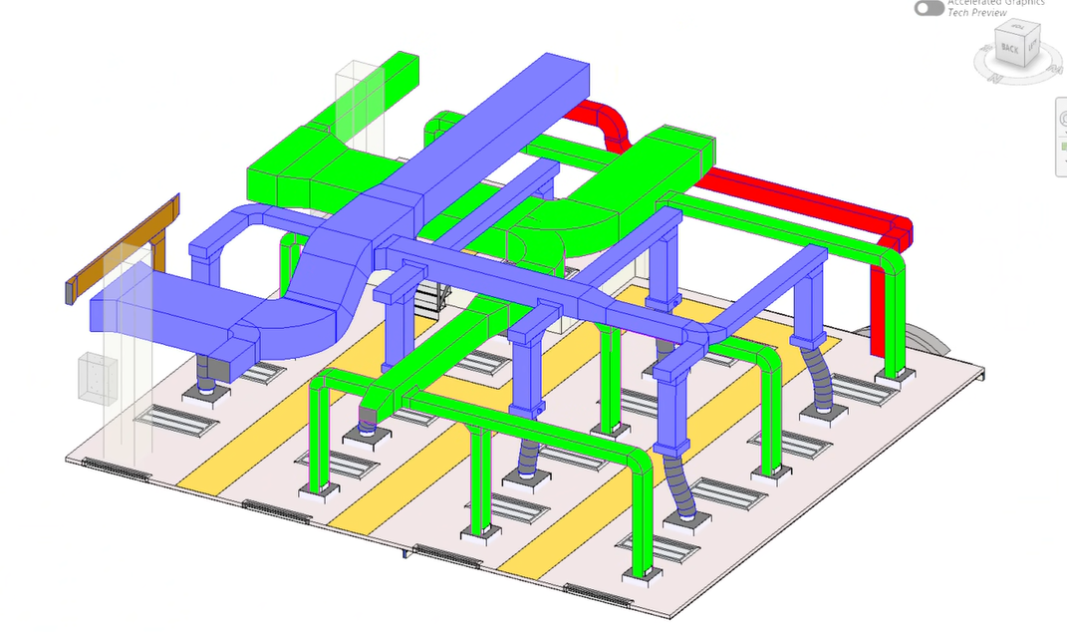
Ducting Layout
Main duct
Branch duct
Dropper duct

Slide 36
Ductwork Calculations
Ducting size
Quantity similar
Duct length
Overall Duct Area

Slide 37
Duct Area quantity
Ductwork Price

Slide 38
Ductwork Comparison
Tender Stage
Construction Stage
Vendor Khoy
Vendor Zincom

Slide 39
Summary Comparison
Although Khoy's unit rate is lower, the total quantity of Duct Area (Sqft) remains the primary cost driver. Accurate quantity verification is therefore more critical than negotiating unit rate discounts.

Slide 40
Summary Comparison
Although Khoy's unit rate is lower, the total quantity of Duct Area (Sqft) remains the primary cost driver. Accurate quantity verification is therefore more critical than negotiating unit rate discounts.

Slide 41
Lesson Learn
Issue Identified
Duct area/quantity underestimated during tender stage.
Impact
Additional material purchase required.
Additional delivery and fabrication costs.
Reduced project profit margin.
Corrective Action
Standardized 3-steps verification process.
Independent quantity review before procurement.
Vendor comparison quantity cross-check.

Slide 42
Conclusion
“A 30-minutes verification can prevent a RM200,000.00 loss tomorrow.”

Slide 43
Project & Construction Department
Equipment Responsibility & Best Practices

Slide 44
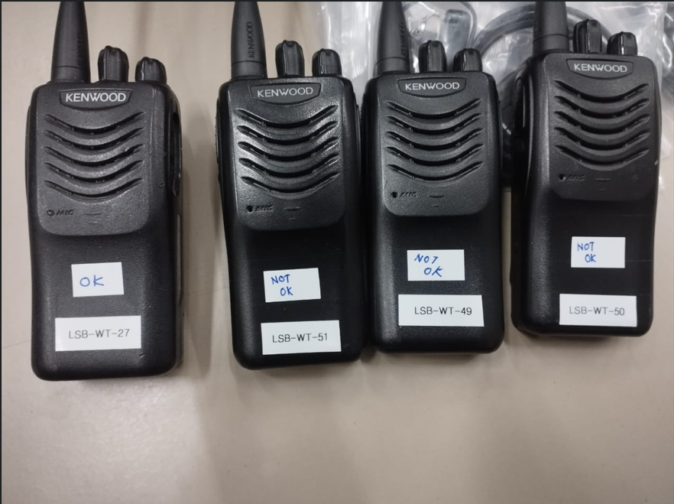
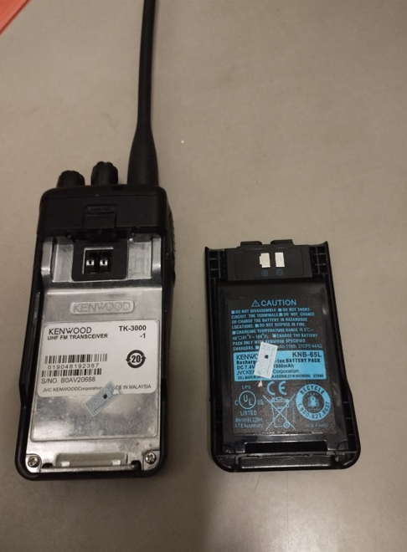
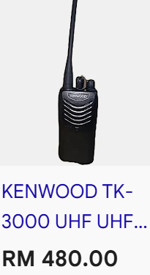
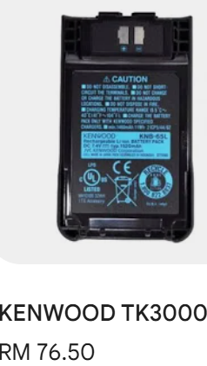
Equipment Responsibility & Best Practices
Replacement Cost
What is the Causes of Damage
Main Risk
Causing Damage
Return & Verify by Nabila
Physical Impact
Rain exposure
Over Charging
Bent or broken antenna
Pulling the radio by the antenna
Borrow To Sub- Contractor with out proper record
Miss Place
IT WASN’T ME
OR
I DON’T KNOW
PLESE HELP TAKEGOOD CARE OF COMPANY ASSETS TO REDUCE UNNECCESSARY EXPENSES AND SUPPORT OPERATIONAL EFFICIENCY

Slide 45
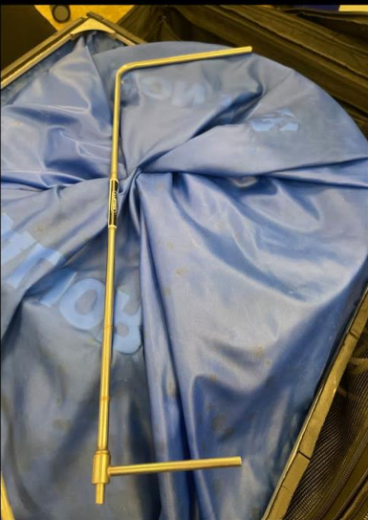
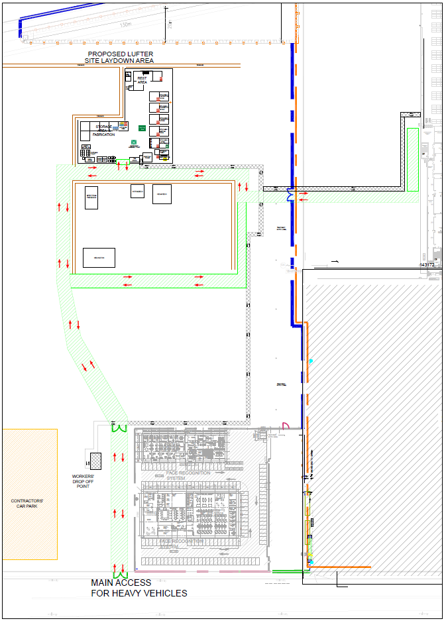
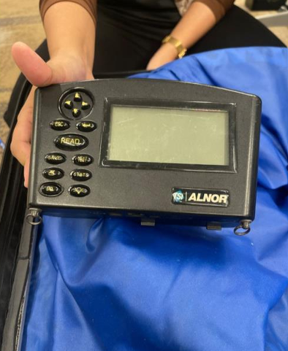
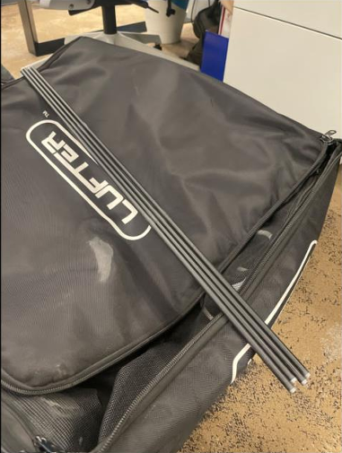
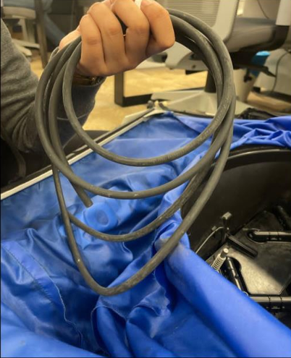
Equipment Responsibility & Best Practices
Kept In Site Store
In Use
Kept In Site Office
Kept In Site Office/Store
Kept In Site

Slide 46
Engineering Department (Project : SKSMC, IVF Level 7)
Topic: Ducting Modification to Eliminate Excessive Sound
Objective: To reduce excessive noise generated at Return Air Grille locating at Staff Change

Slide 47
Case Study
Item | Description
Issue | Loud noise observed from the return air grille
Location | Return Air Grille Staff Change Room
Equipment No | AHU-IVF-02
Date Observed | 07-July-2026
Reported by | Client IVF Level 7
Problem Description | During AHU operation, excessive noise was detected at the return air grille in Staff Change. The noise was continuous and became more noticeable when the AHU was operating.

Slide 48
Investigation Findings
Possible Cause | Investigation Result | Status | Action
Return Grille Undersized | Free area insufficient for design airflow, resulting in high face velocity. | Possible | Checked on internal grille size 150mm x150mm
Excessive Air Velocity | Air velocity at the return grille exceeded recommended limits | Confirmed | Based on ductsizer, air velocity 7.055 m/s which is high.
Dirty Filter | Filter in clean condition. Service on June-2026 | Not the cause | Checked all filter in clean condition.
Loose return grille | No loose components or vibration found. | Not the cause | Return grille in good condition without loose component.
Obstruction in return duct | No blockage detected during inspection. | Not the cause | Checked and verified not obstruct.
Incorrect balancing | Air Balancing have been performed and pass during Cleanroom Performance Test. | Not the cause | Reading measured in specification ( design).

Slide 49
Corrective Action
Action | Responsibility | Status
Review duct pressure loss calculation against design | Free area insufficient for design airflow, resulting in high face velocity. | As per calculated, with duct area 150mm x 150mm result: Velocity : 7.055 m/s Design Flow rate : 315 cfm
Increase return grille size and ducting size | Air velocity at the return grille exceeded recommended limits | Modification duct size from 150mm x150mm to 250mm x 250mm and internal Grille size to 250mm x 250mm. Install new damper size 250mm x 250mm. Velocity : 2.538 m/s Flow rate : 326cfm
Re-balance return air dampers | Filter in clean condition. Service on June-2026 | Rebalance and adjusting damper to record airflow. Reading meet with design 326cfm. The excessive sound eliminate.

Slide 50
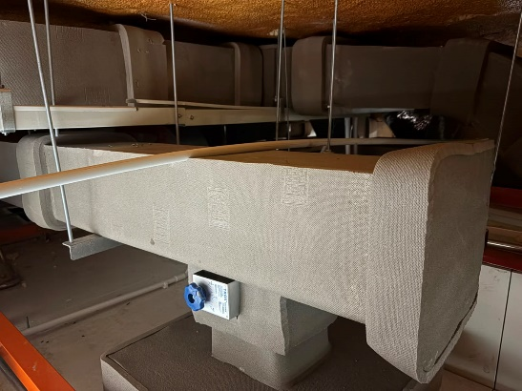
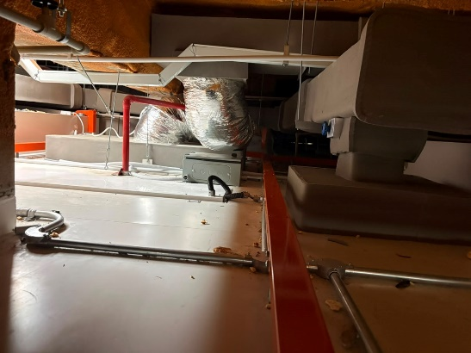
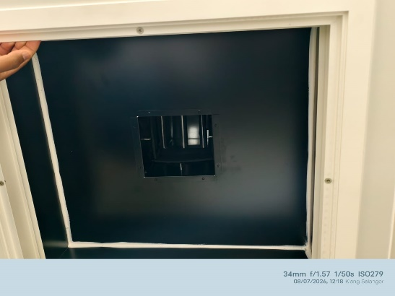
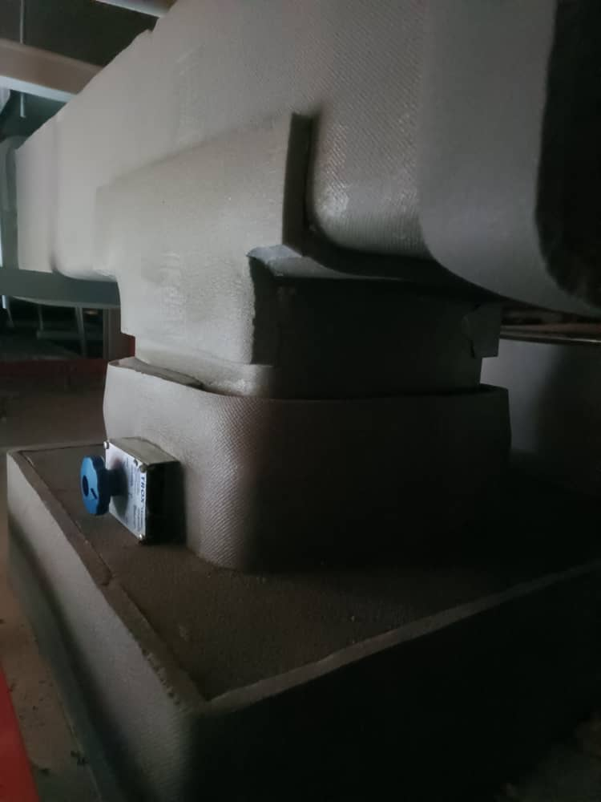
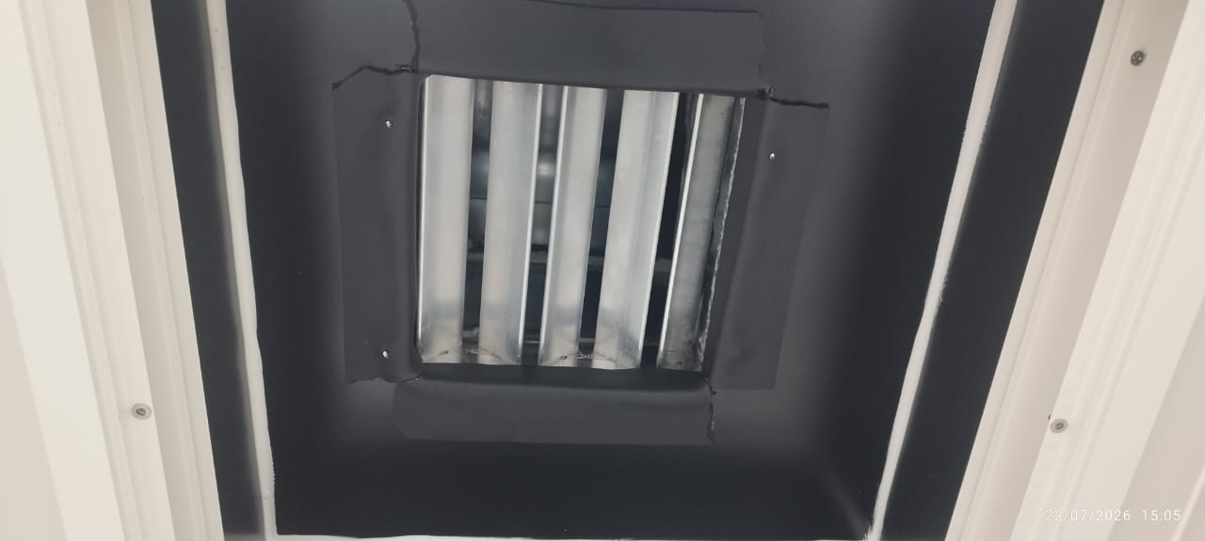
Corrective Action (Picture)
Before Modification
Return Ducting & Damper served for Staff Change size 150mm x 150mm
After Modification
Return Ducting & Damper served for Staff Change upgrade to size 250mm x 250mm
Remarks :
Excessive sound eliminate and witness by Client on 22-Jul-2026

Slide 51
Compliance, Training & Development Department

Slide 52
Results for Quality Objective 2025
Category | Quality Objectives | Analysis Frequency | Analysis Responsibility | Current Results | Meet / Fail
The degree of customer satisfaction | Customer Satisfaction for Project Department To achieve over 80% of customer satisfaction positive feedback. | Yearly | Compliance Department | 85.33% | Meets target
 | Customer Satisfaction for Engineering Department To achieve over 80% of customer satisfaction positive feedback. |  |  | 87.50%
Performance and effectiveness of QMS | Internal Audit To achieve no repeated NC in the internal audit. | Yearly | Compliance Department | Achieved | Meets target
Performance of external providers | Vendor Performances To achieve over 70% of vendor performance satisfaction level. | Yearly | Purchasing Department | 82.95% | Meets target
Conformity of services | Nonconformity Detected After Delivery To control less than 2 warranty claims on room parameter system per project during Defect Liability Period (DLP). | Yearly | Compliance Department | Achieved | Meets target
 | Non-conforming work To achieve less than 3 NC from client and Quality Team during each project life cycle. | Yearly | Compliance Department | Not achieved | Fail
Implementation effectiveness of planning | On-time Project Handover To achieve more than 90% on-time project handover | Yearly | Compliance Department | 100% | Meets target
Notes:
Besarkan graphic & tukar color

Slide 53

Results of Internal Audit 2026
Quality Objectives Target: to achieve no repeated NC in the internal audit.
One (1) repeated NC
Audit No. | Department / Functions | No. of Areas for Improvement | No. of NCs
2026-1 | Quality Management System | 4 | 0
2026-2 | Document Control | 0 | 0
2026-3 | Project 1 (PHUKM01) | 2 | 1
2026-4 | Management | 0 | 0
2026-5 | Administration | 1 | 0
2026-6 | Engineering | 0 | 0
2026-7 | Project 2 (PMCY01) | 4 | 1
2026-8 | Human Resource | 0 | 0
2026-9 | Purchasing & Store | 1 | 0
TOTAL |  | 12 | 2

Slide 54

External Audit 2026
Date
29 – 30 September 2026
On-site Audit
PGSK02
Reminder
📌Maintain compliance with document control and QMS requirements
📌Ensure project traceability and proper execution records
📌Maintain proper control of site activities

Slide 55
Training Timeline Proposed for Year 2026 (Batch 1)
Month | Supervisor/Coordinator/ Executive |  | Engineer |  | Senior Engineer |  | Manager
 | Week 1~2 | Week 3~4 | Week 1~2 | Week 3~4 | Week 1~2 | Week 3~4 | Week 1~2 | Week 3~4
Jul 2026 | REVISION |  | Class 31 | Class 32 | Class 31 | Class 32 | Class 27 | Class 29
Aug 2026 |  |  | Class 33 |  | Class 33 | Class 34 | Class 30 | Class 32
Sep 2026 |  |  |  |  |  |  | Class 33 | Class 34
Oct 2026 |  |  |  |  |  |  | Class 35 | Class 36
Nov 2026
Dec 2026 | Assessment

Slide 56
Training Timeline Proposed for Year 2026 (Batch 2)
Month | Supervisor / Planner |  | Engineer
 | Week 1~2 | Week 3~4 | Week 1~2 | Week 3~4
Jul 2026 | REVISION |  | Class 21 | Class 22
Aug 2026 |  |  | Class 23 | Class 24
Sep 2026 |  |  | Class 25 | Class 26
Oct 2026 |  |  | Class 27 | Class 28
Nov 2026 |  |  | Class 29 | Class 30
Dec 2026 | Assessment

Slide 57
Training Timeline Proposed for Year 2026 (Batch 3 & 4)
Month | Batch 3 |  | Batch 4
 | Week 1~2 | Week 3~4 | Week 1~2 | Week 3~4
Jul 2026 | Class 11 | Class 12 | Class 1 | Class 2
Aug 2026 | Class 13 | Class 14 | Class 3 | Class 4
Sep 2026 | Class 15 | Class 16 | Class 5 | Class 6
Oct 2026 | Class 17 | Class 18 | Class 7 | Class 8
Nov 2026 | Class 19 | Class 20 | Class 9 | Class 10
Dec 2026 | Assessment

Slide 58
Training by Batch
Position | Batch 1 | Batch 2 | Batch 3 | Batch 4
Supervisor | Izzat Zul Majdi Muhammad Waridh Aiman Khair Zainal | Nor Danial Iman | - | Azfar Aeiman
Planner / Coordinator | Muhammad Naim Ikhmal | Nurul Huda Nadia | - | -
Executive | Nabil Aiman | - | Mohamad Faiz Muhammad Syaakir Ahmad Afham Muhammad Nazhan | Muhammad Shazany Shahril Azri Haikal Muhammad Nuriman Amri Mukhlis
Engineer | Mohammad Fadzli | Khairul Anwar Lim Ahmad Mursyid Muhammad Izzat Muhammad Syazwan Fikri | Muhamad Zharif Tuan Muhammad ‘Ammar Yazrin Afif Nur Ainina Dhiren Singh Mohamad Zulfadhli | Muhammad Hazim Arif Muhammad Hazim Mahadi Luqman Nul Hakim
Senior Engineer | Adib Safuan Muhammad Haris Mohd Izzan Irfan Syed Mohamed Fairiq | - | - | Lim Zhi Qin
Assistant Manager | Leong Wai Lek | - | - | -
Manager / Senior Manager | Deyna Cheng Su Lin Koh Soon Yong Ahmad Na’im Cheng Yuk Lun Tan Han Loong | - | - | Ooi Cheah Peng

Slide 59
Class & Topic Proposed for Year 2026
Class No. | Training Topic
Class 1 | Quality Management System and Quality Objectives, Account - Claim Procedure, Purchasing Department Briefing, GDP and Organization
Class 2 | Project Drawing Control
Class 3 | Project Preparation and Site Readiness
Class 4 | Project Department Standard Operating Procedures
Class 5 | Site Safety Induction, First Aid & Site Housekeeping
Class 6 | Safety Information & Reporting
Class 7 | Install & Insulate Ducting System + Typical Detail - Ducting + Welded Duct Installation
Class 8 | Chilled Condenser Water Pipe Installation + Typical Detail - Chilled Condenser Water Pipe
Class 9 | Copper Piping
Class 10 | Cleanroom Panel Installation
Class 11 | Electrical Board Installation
Class 12 | Self-Levelling Epoxy Floor Installation
Class 13 | AHU & FCU Installation
Class 14 | HEPA Filter Installation (Chamber & Terminal)
Class 15 | Cleanroom Technical Cleaning
Class 16 | Site Demobilization
Class 17 | Electrical & Wiring Installation
Class 18 | Pass Box Installation
Class 19 | HVAC Air Balancing & Pressure Gauge Installation
Class 20 | Testing & Commissioning

Slide 60
Class & Topic Proposed for Year 2026
Class No. | Training Topic
Class 21 | Project Files and Related Document
Class 22 | Equipment and Material Lifting
Class 23 | Project Delivery Process Flow
Class 24 | Validation, Commissioning and Qualification
Class 25 | Project Kick Off
Class 26 | Lead Sheet and Clean Wall Panel Installation for Hotlab
Class 27 | Design Table Application (Excel) and SAG/RAG Selection
Class 28 | Understanding of Basic HVAC Design, Air Side Filtration System
Class 29 | Psychromatic Chart Application
Class 30 | HVAC Control System, BMS/EMS General / Typical System
Class 31 | Duct Sizing, HVAC System
Class 32 | CHW / CDW Pipe Sizing, System Sizing & Typical P&ID ACAD for the HVAC System
Class 33 | Microsoft Project
Class 34 | E-20 Application
Class 35 | Project Management 1
Class 36 | Project Management 2
Class 37 | External Training
Class 38 | External Training
Class 39 | External Training
Class 40 | External Training

Slide 61
Project Admin

Slide 62
Standard Folder Update
Standard Folder (Tender, Job & Project) updated from 2024 to revision 2026
Tender : \\lufterserver\Lufter\PROJECTS & JOBS\SAMPLE STANDARD TENDER FOLDER\TENDER SUBMISSION STANDARDS
Job & Project : \\lufterserver\Lufter\PROJECTS & JOBS\SAMPLE STANDARD FOLDER\2026
Same update applies to Beluften documents.

Slide 63
Equipment Booking Procedure / Stock In & Out
Borrowing Procedure
Project Team inform Project Admin / Store Executive
PA / Store Executive check the availability of requested items
NOT AVAILABLE
AVAILABLE
PA to order
PA / Store Executive prepares the item
Inform Project Team once items available
Project Team to fill in Material Requisition & Stock Out form and update in Project Materials & Equipment List
Project Team brings the forms to collect the items
PA update in store logbook

Slide 64
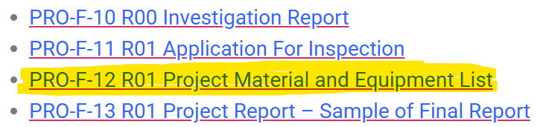
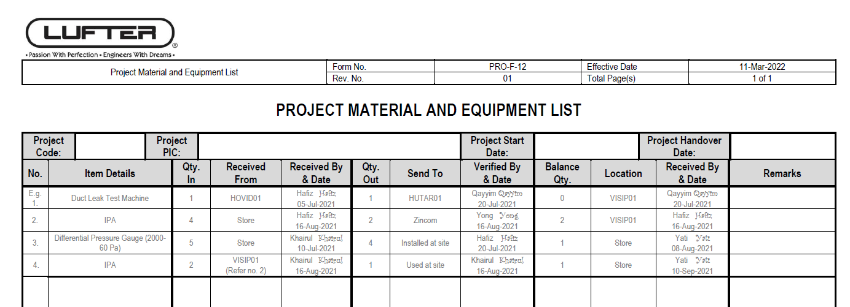

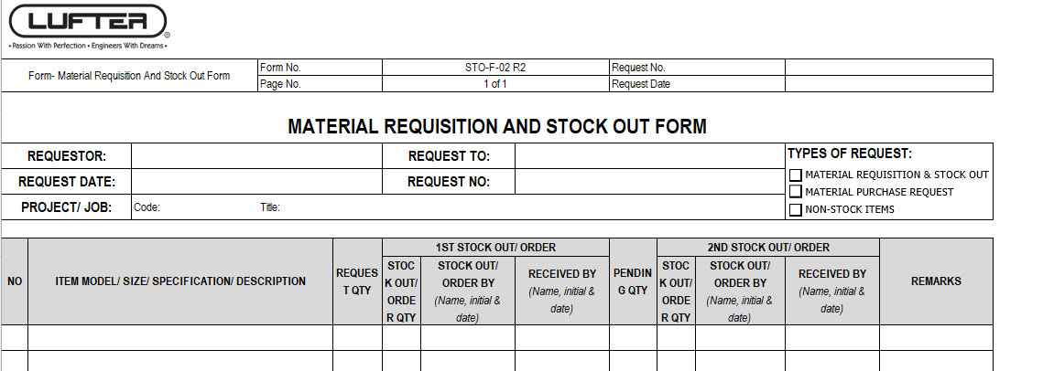
Equipment / Material Request
Update Project Material & Equipment List
Bring every time take items from store/office store
Project
Store

Slide 65
Equipment Booking Procedure / Stock In & Out
Returning Procedure
Project Team inform Project Admin / Store Executive
Return item
(Please ensure the items are clean before returning!!)
NO DEFECTS
PA / Store Executive check the items
DEFECTS
Rectify Items
Replace New
Record in Store Log Book

Slide 66
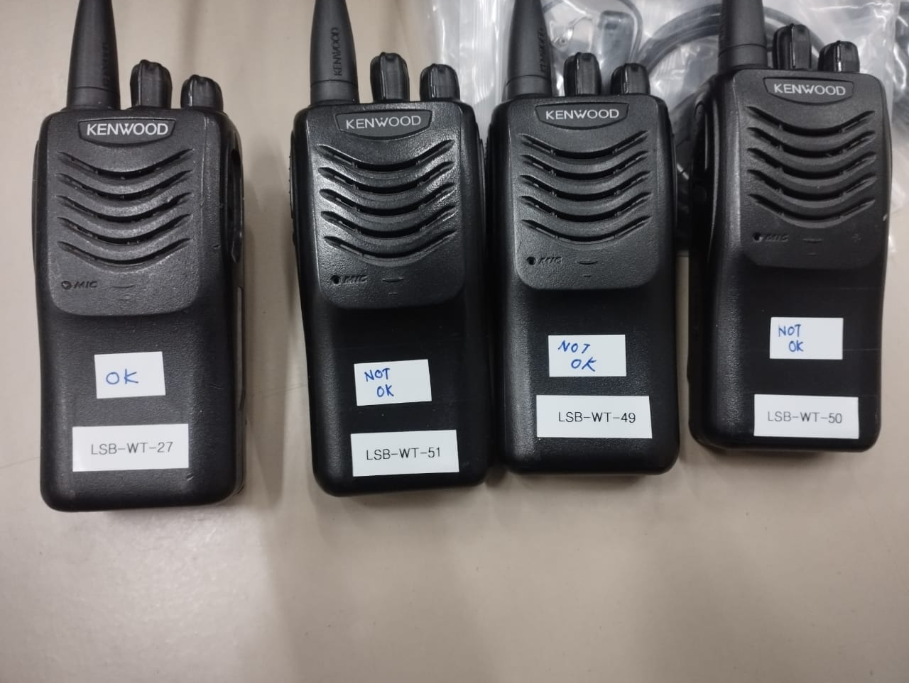
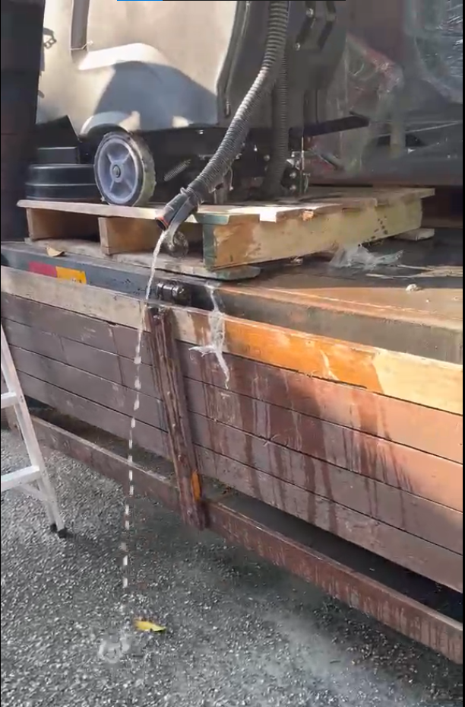
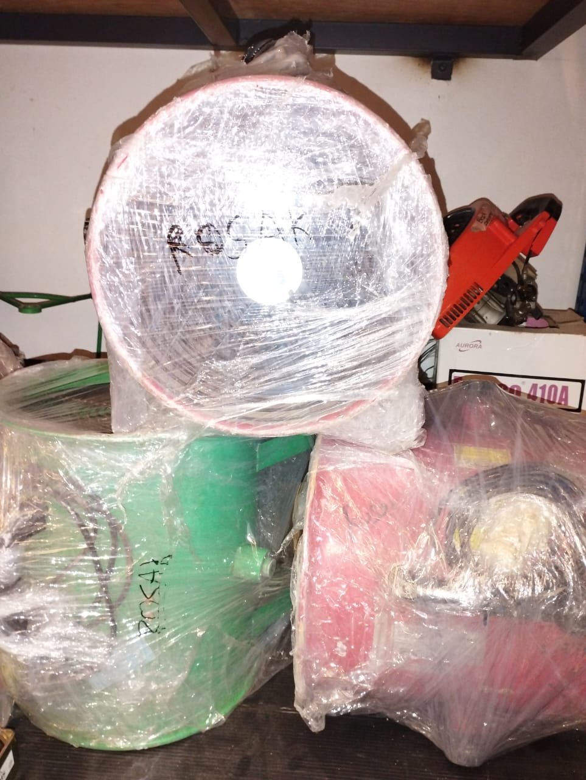
Equipment Booking Procedure (Returning)
Please clean all borrowed equipment and remove any dust or water before returning it.
Please indicate any broken equipment for our further inspection.
If any damaged asset is disposed of on-site, please inform us.

Slide 67



Request 1 week @ 5 days before
No last minute request
Flight Booking
1
Requestor get approval from manager to book flight
2
Requestor inform Project Admin (PA) with preferred date, time & airlines
3
PA fill out Flight Booking Request (ADM-F-001) form
4
PA Get approval from requestor’s Manager, Senior Management & Finance Department
5
PA inform Acc. Manager and make payment for flight booking
6
Print invoice & Flight Booking Request form – 1 copy for Acc. Manager. Save 1 copy in Admin Folder
7
Email/WhatsApp the itinerary to requestor.

Slide 68


Note: House rental is subject to CKAPS/NPRA approval before the rental period begins.
Accommodation Booking Procedure
1
Requestor get approval from manager and inform PA to book accommodation
2
Check availability of accommodation based on request
3
Fill out Accommodation Booking Request Form (ADM-F-002)
4
Get approval from Manager, Senior Management & Finance Department
5
Inform Acc. Manager to make payment
6
Print invoice & Flight Booking Request form – 1 copy for Acc. Manager. Save 1 copy in Admin Folder
7
Email/WhatsApp the booking details to requestor

Slide 69
Asset Tagging (Tool / Equipment / Project Item)
1
Tools / equipment purchase at site or for project use.
2
Inform PA via email or WhatsApp with item name, model, serial number, quantity, item photo & DO/Invoice
3
Admin will filled up the details accordingly.
4
Admin will provide the asset number / tagging number for the equipment / tools / items.
5
Item details will provide to Accounts department for their record and acknowledgement.
6
Attachments will be saved in respective folder for reference.
(if any)

Slide 70
Document Control

Slide 71
Latest Document Updates
May-2026 :
PRO-F-96 Duct Leak Test
Jun-2026 :
PRO-SOP-02 R05 Design and Development
PRO-SOP-04 R05 Project Planning and Control
PRO-SOP-06 R04 Contract Review

Slide 72
Latest Document Updates
Jul-2026 (Approval in Progress):
PRO-SOP-04 R06 Project Planning and Control
PRO-F-39 R03 Drawing Transmittal List

Slide 73
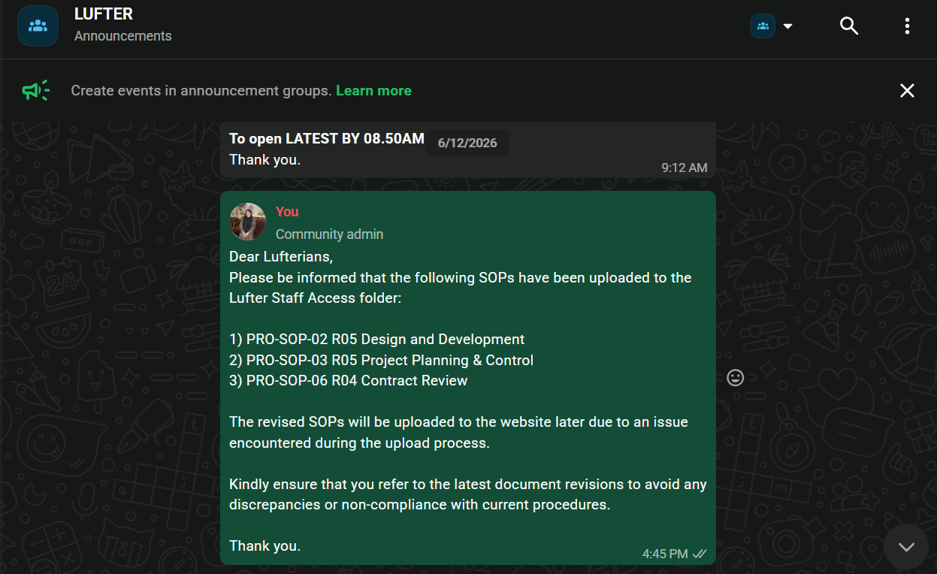

Where To Find Lufter Documents?
Announcement of New & Revised Documents

Slide 74
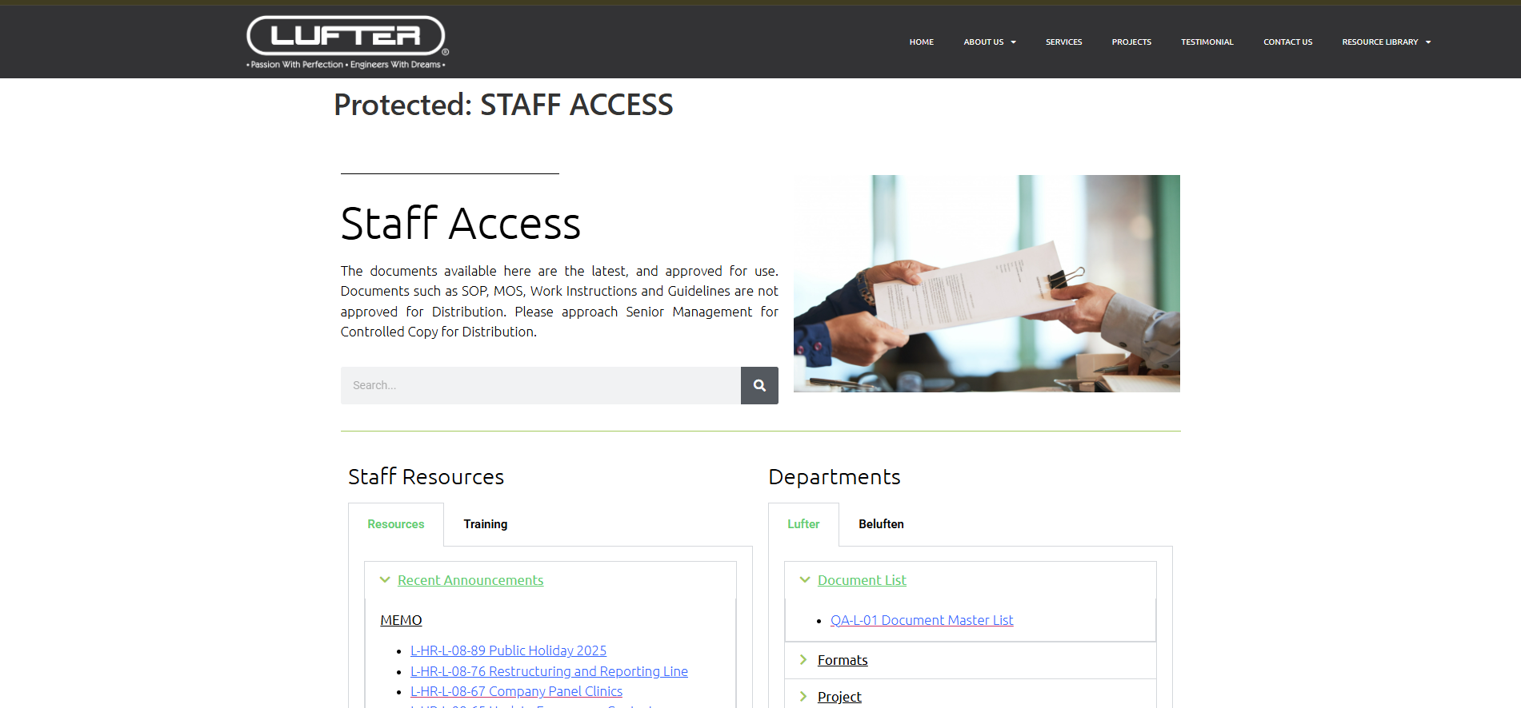
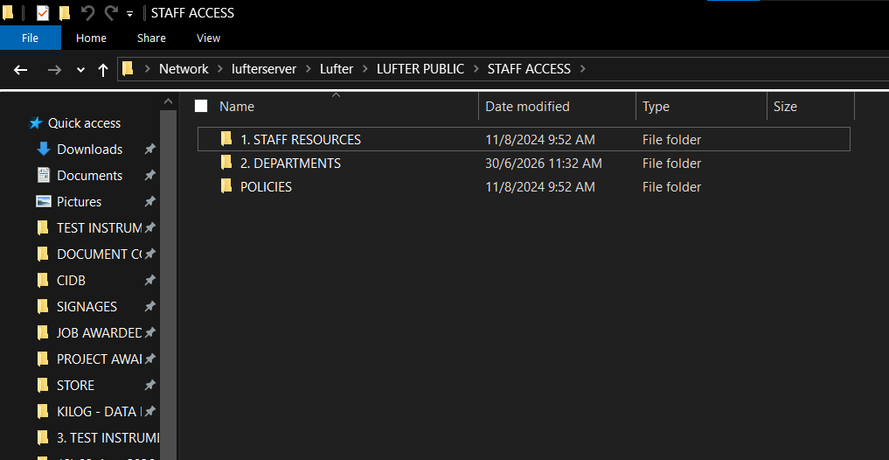
Where To Find Lufter Documents?
LUFTER Website
https://www.lufter.com.my/staff-access/
Password : 0218Lufter2026
2. Server Access
\\lufterserver\Lufter\LUFTER PUBLIC\STAFF ACCESS

Slide 75

Document Codification
Please ensure that file names comply with the standard document codification guidelines.
https://www.lufter.com.my/wp-content/uploads/2023/05/QA-GD-01-R04-Codification-of-Documents-Guideline-WM.pdf

Slide 76
Account Department

Slide 77
E-Invoice
In accordance with the e-Invoicing requirements implemented by the Inland Revenue Board of Malaysia (IRBM), all employees are required to comply with the following guidelines when submitting staff expense claims.
All supporting invoices submitted for reimbursement must be valid e-Invoices and contain the following mandatory information:
Supplier's name and business registration number;
e-Invoice number and issuance date;
Clear description of the goods purchased or services rendered;
Total invoice amount; and
Sales and Service Tax (SST) amount, where applicable.
Claims submitted with incomplete, inaccurate, or non-compliant supporting documents may be delayed or rejected pending the provision of the required information.

Slide 78
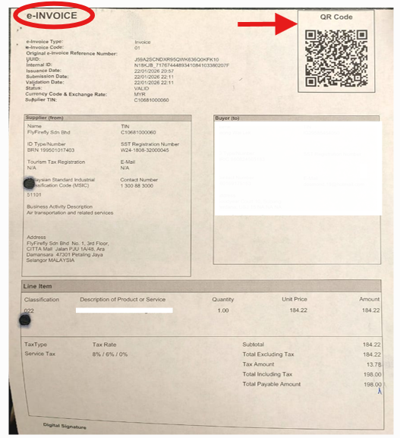
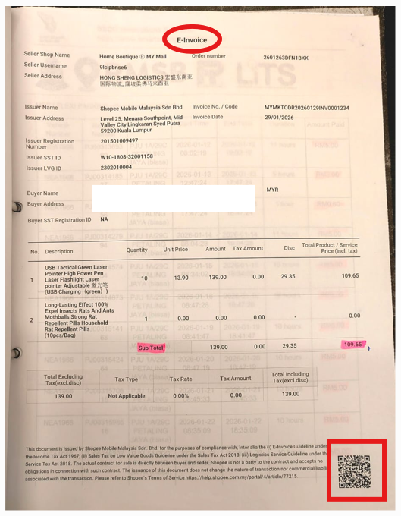
E-invoice
Example of E-Invoice:
Figure 1
Figure 2

Slide 79
E-INVOICE
Examples of Bills / Receipts That MUST Be in the Form of e-Invoices:
Hotel accommodation
Flight tickets / travel agents
Training courses / seminars
Medical clinics / hospitals
Professional services
Telecommunication bills
Online purchases from registered platforms (e.g. Shopee, Lazada, or other e-commerce platforms)
Any supplier who is able to issue e-Invoices (request to bill under company’s name)
Bills That May Still Be Submitted Using Normal Receipts (Non-e-Invoices)
Parking fees
Tolls
Petrol
Public transportation (e.g. Grab, MRT, etc.)
Small retail purchases where e-Invoices are not available
Claims from individuals or hawkers not registered for e-Invoicing

Slide 80
Company Details
Lufter Sdn. Bhd.
Beluften Sdn. Bhd.
C20379358070
200701023623
B16-2507-32000580
Tax Identification No. (TIN)
Registration No. (NEW)
SST Registration No.
C21200694000
201001026613
B16-2409-32000027

Slide 81

Q&A

Slide 82
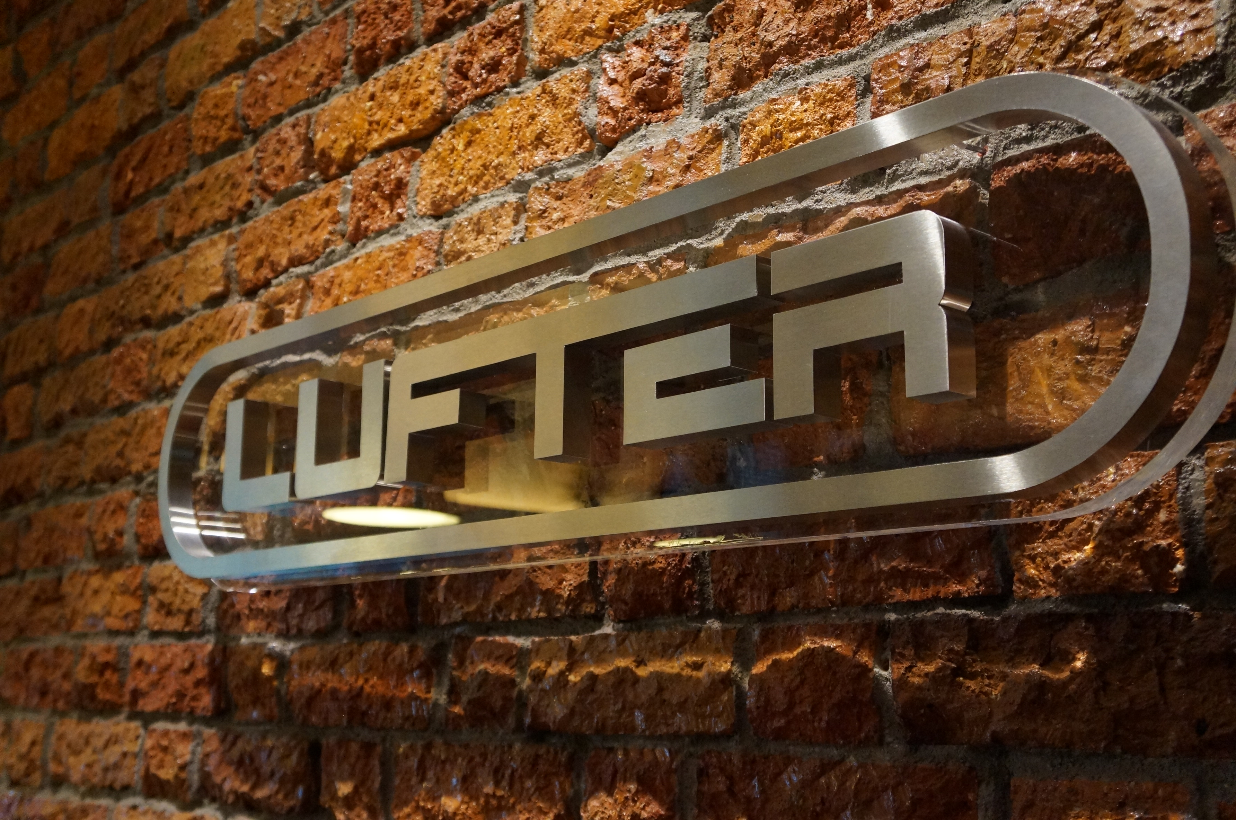
End of Presentation

